Slide 1
Phone Marketing Decision Model for Retail Banking
Turning Data into Insights
LARA ZEFANI
I developed a classification model that will further refine the bank's ability to predict customer behavior. This model will enable the bank to make data-driven decisions regarding its phone marketing strategy, ensuring that resources are allocated efficiently and effectively. As a result, the bank will be able to optimize its calling strategy based on the insights generated from my analysis.
HTTPS://WWW.LINKEDIN.COM/IN/LARAZEFANI/

Slide 2
COLLECT DATA
1
Analysis Process
CLEAN DATA
2
ANALYZE DATA
3
5 Key Steps to Analyze Data
I start with data collection from Kaggle, ensuring accuracy and completeness for reliable analysis. Next, I perform data cleaning, handling inconsistencies and missing values. Then, I analyze the data using machine learning to uncover patterns and trends. After that, I focus on data interpretation, extracting insights and validating hypotheses. Finally, I use data visualization through charts and dashboards to present findings clearly, enabling stakeholders to make informed decisions. Each step is crucial for effective data-driven insights.
INTERPRET RESULTS
4
VISUALIZE FINDINGS
5

Slide 3



Tools for Analysis

Slide 4
Load The Dataset
https://www.kaggle.com/datasets/henriqueyamahata/bank-marketing

Slide 5

What is being classified?
Subscribe vs. Do Not Subscribe
The classification model is predicting whether a customer will subscribe or not subscribe to the bank's offer based on their behavior, helping optimize the phone marketing strategy.

Slide 6
Train the Classification Model
Random Forest Classification with Scikit-Learn
The Random Forest algorithm works by creating a multitude of decision trees during the training phase. Each tree is constructed using a random subset of the data and a random subset of features. This randomness introduces variability among individual trees, reducing the risk of overfitting and improving overall prediction performance.

Slide 7
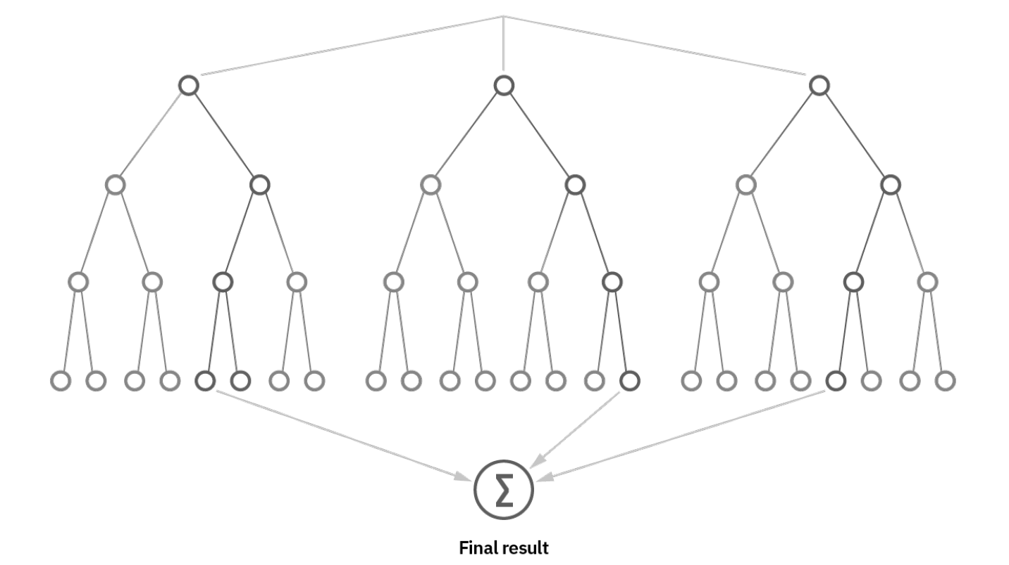
Classification Report
Accuracy: 0.89 Precision: 0.52 Recall: 0.28 F1-Score: 0.36
ROC-AUC: 0.62

Slide 8
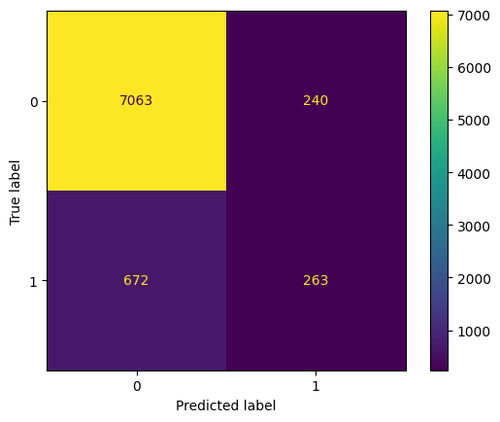
Confusion
Matrix
Confusion Matrix
A confusion matrix is a simple table that shows how well a classification model is performing by comparing its predictions to the actual results. It breaks down the predictions into four categories: correct predictions for both classes (true positives and true negatives) and incorrect predictions (false positives and false negatives).

Slide 9
Decision Tree of The Model
You can access the full image of the decision tree of the model by clicking the link below:
https://www.kaggle.com/datasets/henriqueyamahata/bank-marketing

Slide 10

Feature Importance Analysis
Why?
To understand which features contribute the most to the overall model decision-making.

Slide 11
Feature Importance Analysis
Using SHAP
(SHapley Additive exPlanations)

Slide 12
Thankyou
LARA ZEFANI
Unlock the Power of Data!
HTTPS://WWW.LINKEDIN.COM/IN/LARAZEFANI/

